Slide 1
Flutter – Input Types and Controller

Slide 2
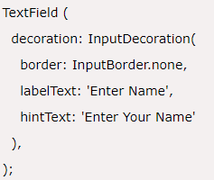
TextField
A TextField or TextBox is an input element which holds the alphanumeric data, such as name, password, address, etc.
The following code explains a demo example of TextFiled widget in Flutter:

Slide 3
TextField – (contd…)
Some of the most common attributes used with the TextField widget are as follows:
decoration: It is used to show the decoration around TextField.
border: It is used to create a default rounded rectangle border around TextField.
labelText: It is used to show the label text on the selection of TextField.
hintText: It is used to show the hint text inside TextField.
icon: It is used to add icons directly to the TextField.

Slide 4
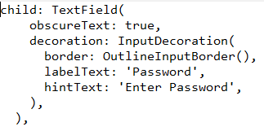
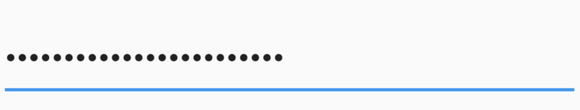
1. TextField - obscureField
obscureField : True
This property allows a widget to store data and hide it from user like password

Slide 5

2. KeyBoard Types
A TextField allows you to customise the type of keyboard that shows up when the TextField is brought into focus.
The types are:
TextInputType.text (Normal complete keyboard)
TextInputType.number (A numerical keyboard)
TextInputType.emailAddress (Normal keyboard with an “@”)
TextInputType.datetime (Numerical keyboard with a “/” and “:”)
TextInputType.numberWithOptions (Numerical keyboard with options to enabled signed and decimal mode)
TextInputType.multiline (Optimises for multi-line information)

Slide 6
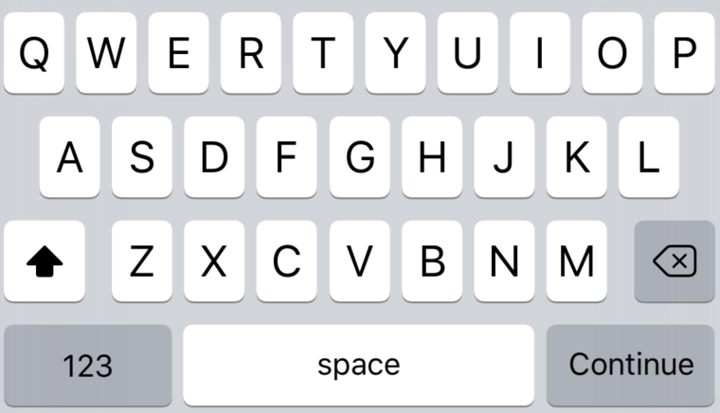

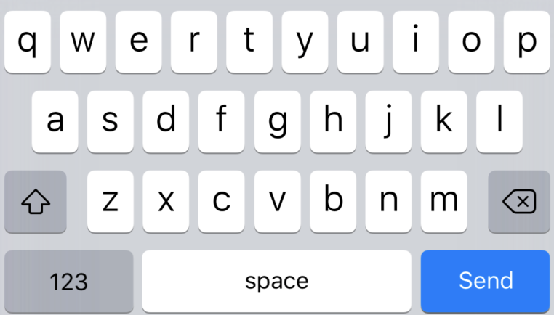

3. TextInputAction
Changing textInputAction of the TextField lets you change the action button of the keyboard itself.
OR

Slide 7

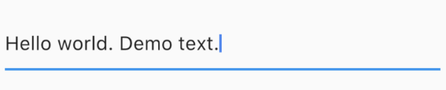

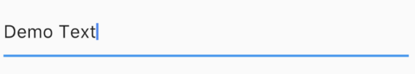
4. Text Capitalization
The TextField provides a few options on how to capitalise letters in the input from the user
The types are:
TextCapitalization.sentences
TextCapitalization.characters
TextCapitalization.words

Slide 8


5. Text Style, Alignment and Cursor Options
Text alignment inside the TextField
Use the textAlign property to adjust where cursor is inside the TextField
This has the usual alignment properties: start, end, left, right, center, justify.

Slide 9


6. Styling the text inside the TextField
We use the style property to change how the text inside the TextField looks.

Slide 10


7. Changing the cursor in the TextField
The cursor is customisable directly from the TextField widget
You are allowed to change the cursor color, width and radius of the corners. For example, here I make a circular red cursor for no apparent reason

Slide 11

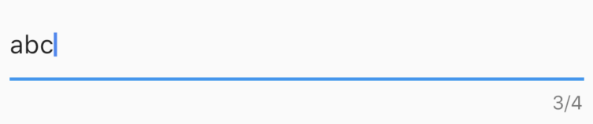
8. Controlling the Size and Maximum Length in a TextField
TextFields can control the maximum number of characters written inside it, the maximum number of lines and expand as text is typed.
Controlling max characters

Slide 12
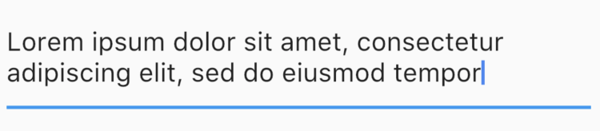


9. Making an expandable TextField
Sometimes, we need a TextField that expands when one line is finished. In Flutter it is slightly odd (yet easy) to do. To do this, we set maxLines to null, which is 1 by default.

Slide 13
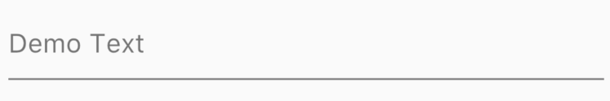
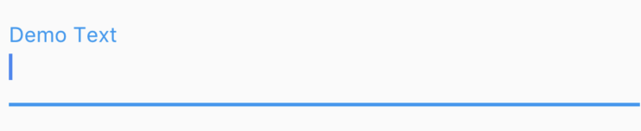


10. Decorating the TextField
Till now we focused on the features Flutter offers for input.
For decorating the TextField, we use the decoration property which takes an InputDecoration
Use the hint and label properties to give information to the user
Hint :
Label :
You can add icons using “icon”, “prefixIcon” and “suffixIcon”

Slide 14
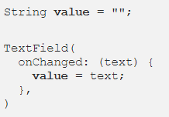
11. Retrieving information from a TextField
The easiest way to do this is to use the onChanged method and store the current value in a simple variable. Here is the sample code for it:

Slide 15
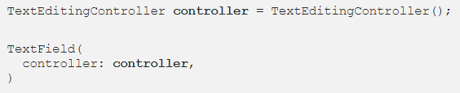

11. Retrieving information from a TextField (contd…)
The second way to do this is to use a TextEditingController. The controller is attached to the TextField and lets us listen and control the text of the TextField as well
And we can listen to changes using

Slide 16

Other callbacks from the TextField
The TextField widget also provides other callbacks such as
onEditingCompleted
onSubmitted

Slide 17
Flutter : State Management

Slide 18
Flutter – State Management
Managing state in an application is one of the most important and necessary process in the
Let us consider a simple shopping cart application.
User will login using their credentials into the application.
Once user is logged in, the application should persist the logged in user detail in all the screen.
Again, when the user selects a product and saved into a cart, the cart information should persist between the pages until the user checked out the cart.
User and their cart information at any instance is called the state of the application at that instance. life cycle of an application.

Slide 19
Flutter – State Management
A state management can be divided into two categories based on the duration the particular state lasts in an application.
Ephemeral − Last for a few seconds like the current state of an animation or a single page like current rating of a product. Flutter supports its through StatefulWidget.
app state − Last for entire application like logged in user details, cart information, etc., Flutter supports its through scoped_mode

Slide 20



Ephemeral State Management
Since Flutter application is composed of widgets, the state management is also done by widgets
The entry point of the state management is Statefulwidget.
Create a state for RatingBox, _RatingBoxState by inheriting State
Override the createState of StatefulWidget method to create the state, _RatingBoxState

Slide 21
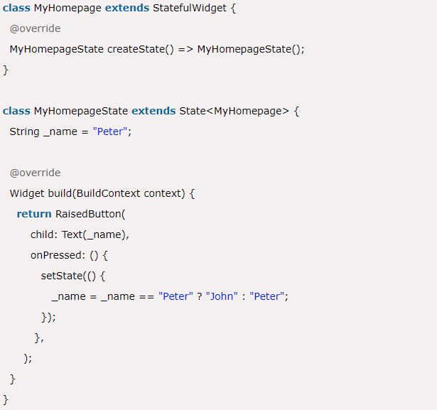
Ephemeral State Management : Example
This state is also known as UI State or local state. It is a type of state which is related to the specific widget, or you can say that it is a state that contains in a single widget. In this kind of state, you do not need to use state management techniques. The common example of this state is Text Field.

Slide 22
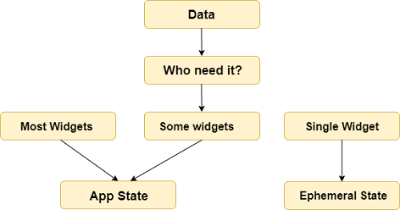
App State – State Management
It is a type of state that we want to share across various parts of our app and want to keep between user sessions.
Some of the examples of this state are User preferences, Login info, notifications in a social networking app, the shopping cart in an e-commerce app, read/unread state of articles in a news app, etc

Slide 23
App State – State Management (contd…)
The simplest example of app state management can be learned by using the provider package.
The state management with the provider is easy to understand and requires less coding.
A provider is a third-party library. Here, we need to understand three main concepts to use this library.
ChangeNotifier
ChangeNotifierProvider
Consumer

Slide 24
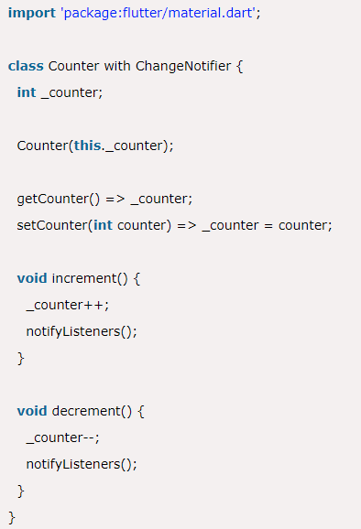
ChangeNotifier
ChangeNotifier is a simple class, which provides change notification to its listeners.
It is easy to understand, implement, and optimized for a small number of listeners.
It is used for the listener to observe a model for changes. In this, we only use the notifyListener() method to inform the listeners.

